Slide 1
Data Visualization
Advanced Data Analysis
February 5, 2020

Slide 2
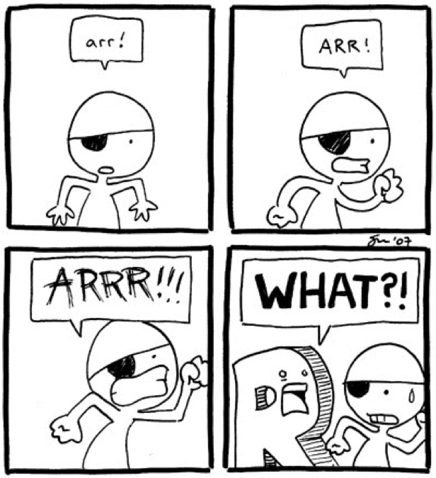
Goals for Today
Fundamentals of the ggplot2 package
Highlight the flexibility of ggplot2
Know what to Google

Slide 3
Where To Start?
What information do you want your reader to know?
Central tendency (means/medians) vs. individual data points?
Do you want to show differences between groups?
If you only submitted a couple of figures to a journal/professor, would the reader be able to understand the point you’re trying to make?

Slide 4
Where To Start?
ggplot2 is SO COOL, but SO picky.
Your data must be in the perfect format, or else it gets really mad
Ideally, you want your data to be in a data.frame (not individual vectors)
Happiest when data are in the long format (not wide!)
Are categorical variables treated as factors/characters/numbers?
Are all the pieces of information you want in your plot located in a single data.frame or are there multiple data.frames?
This is known as “data wrangling” – NOT covering this today
See tidyverse, look into functions like: spread, gather, summarize, mutate, select, group_by, join, filter…
For more info: https://rpubs.com/bradleyboehmke/data_wrangling
Notes:
Difference between long and wide format → Several lines per observation vs. each observation is a line, with several columns per observation (ex: the jail data I have is wide); wide data is usually more common
Ggplot requires Long data

Slide 5
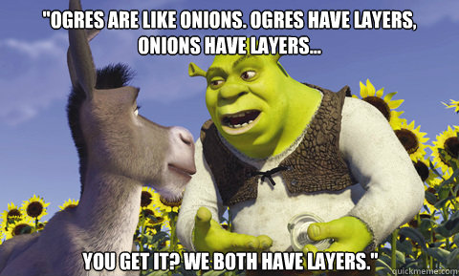
Plotting with ggplot2

Slide 6
Plotting
ggplot2 has the following structure:
ggplot(things that impact entire plot) +
geom_something (things that
impact just the something)
Notes:
Ggplot made entirely of layers; you add layers with a plus sign (the + must be at the end of the line, rather than the beginning; it cannot start a line)

Slide 7
Plotting
A geom_ normally means shape. What shapes do you want to use to represent your plot?
geom_histogram
geom_density
geom_boxplot
geom_point
geom_col
geom_violin

Slide 8
Plotting
ggplot()and each geom_() can take on different aesthetics as an aes() argument.
What do you want your plot to look like? How can you make it pretty?
Which variables are the x-axis and y-axis?
color (should you color the plot by some variable?)
fill (very similar to color, should you fill the plot in somehow)
shape (represent groups using different shapes)
size (represent groups using different sizes)
Notes:
Fill/color distinction – if one doesn’t work, try the other
BRISTISSS spellings

Slide 9
Plotting
Usually aes() contains some information from the data.
If the information isn’t based on the data, it doesn’t need to be inside an aes()
ggplot(data = iris, aes(x = Sepal.Length,
y = Sepal.Width)) +
geom_point(color = “cornflowerblue”)
ggplot(data = iris, aes(x = Sepal.Length,
y = Sepal.Width)) +
geom_point(aes(color = Species))
Notes:
Default
We can change colours
Can change color by a factor
DO THIS IN R

